Slide 1
Welcome Stewards! Catholic Diocese of Rochester
Fr. Mark G. Reamer, O.F.M.
Siena College
Loudonville, New York
Ms. Sue Mathys
The Catholic Community of St. Francis of Assisi
Raleigh, North Carolina

Slide 2
9:15 a.m. Keynote, Part 1 (Fr. Mark Reamer) The inspirational talk will reflect Matthew 10:8 and the bishops’ definition of stewardship:
“We receive God's gifts gratefully,
cultivate them responsibly,
share them lovingly in justice with others,
and return them with increase to the Lord.”
Fr. Mark will inspire us to live the vision of stewardship (not just pay the bills!)
while challenging us to bring forth
the gifts of the baptized.

Slide 3
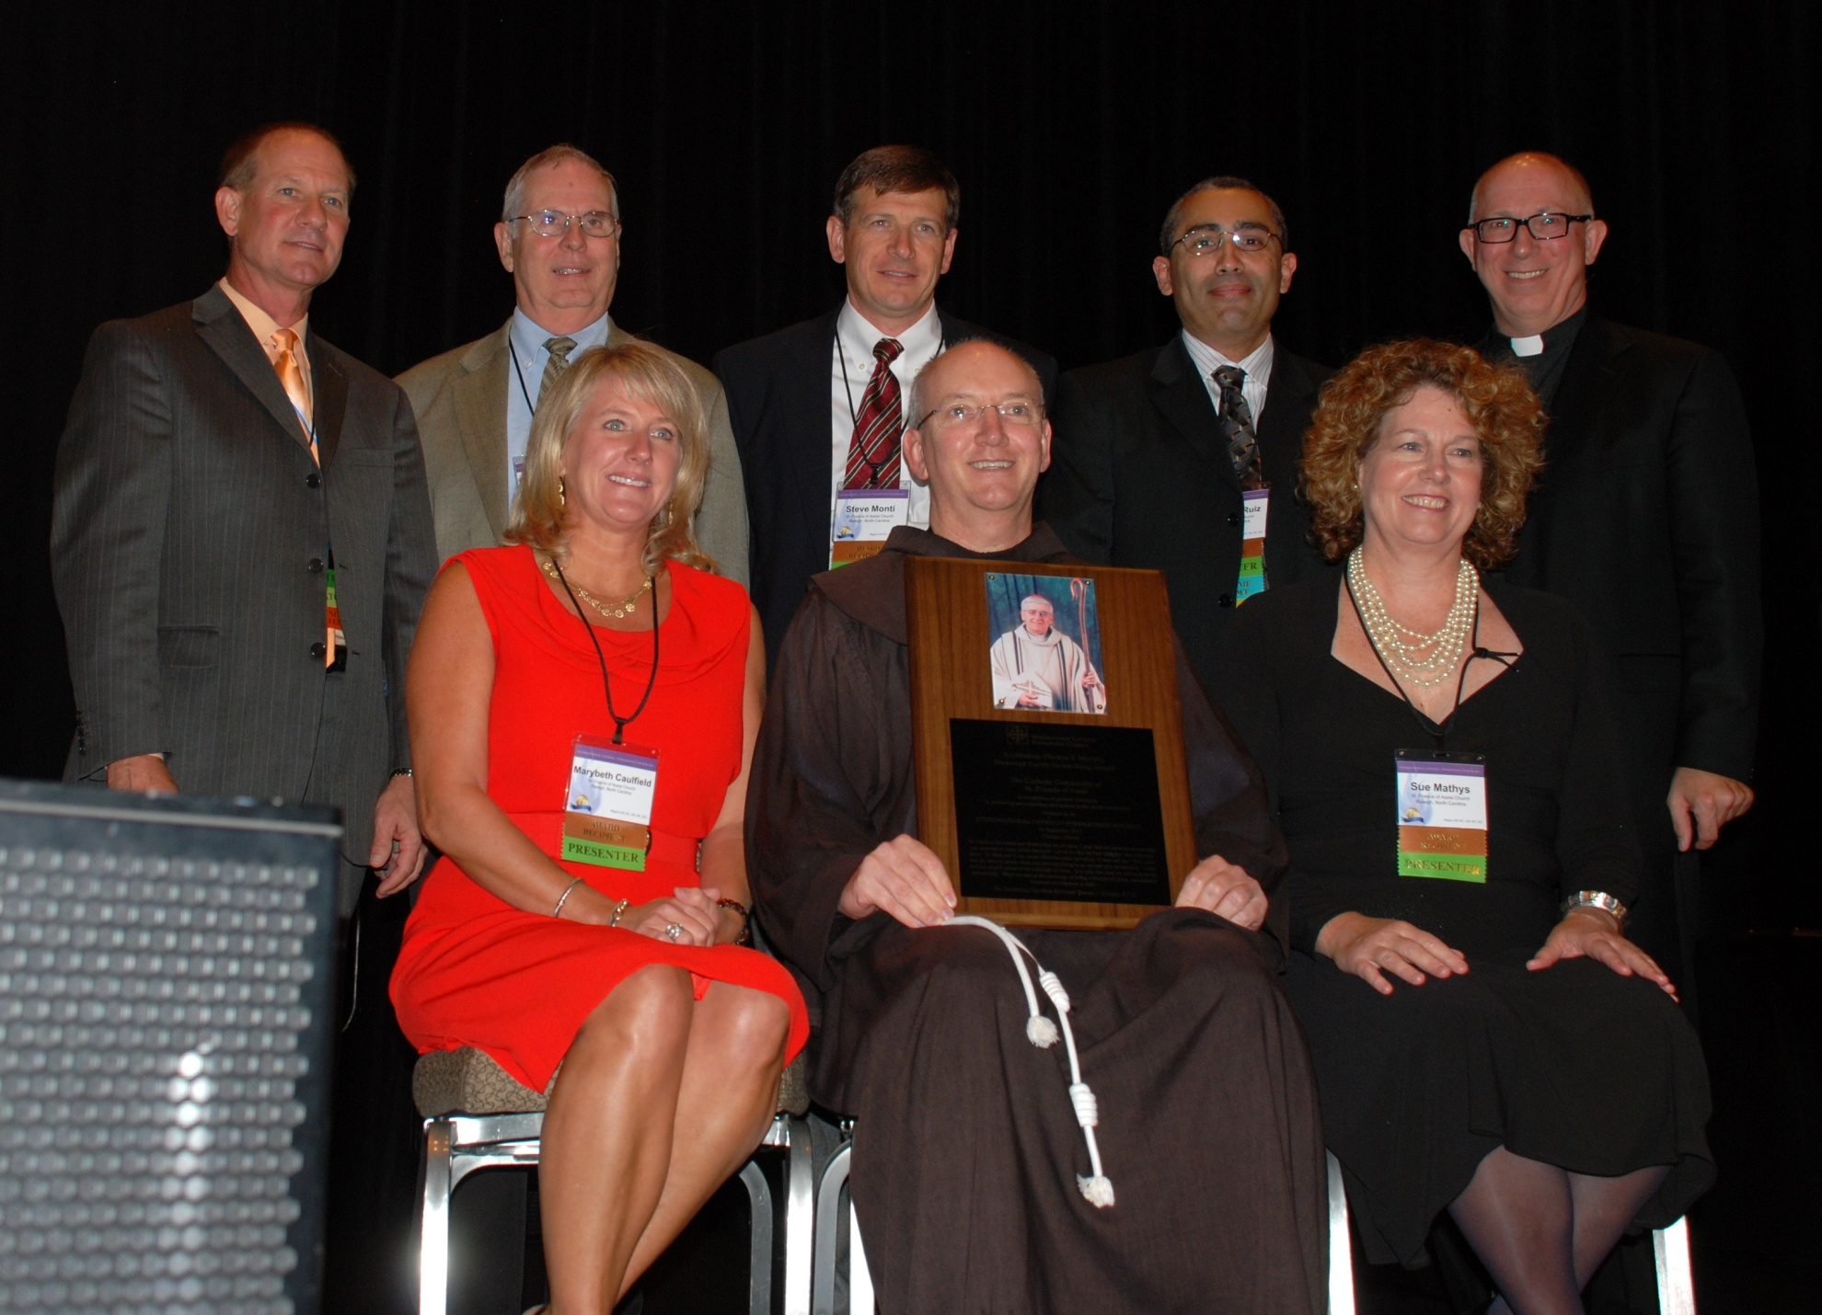

Slide 4
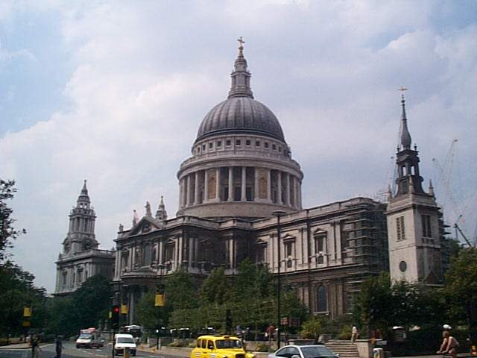
St. Paul’s Cathedral in London
Sir
Christopher
Wren
The
Cathedral’s
architect
Notes:
Construction projects taking place – reminds me of this story.
The story is old and probably familiar, but it illustrates a powerful point. One morning, during the construction of St. Paul's Cathedral in London, Sir Christopher Wren, the Cathedral’s architect, came upon two stonecutters, and asked what they were doing. The first man answered, 'I’m cutting stone.' But the second man said, 'I’m part of a group that’s building a cathedral.'

Slide 5
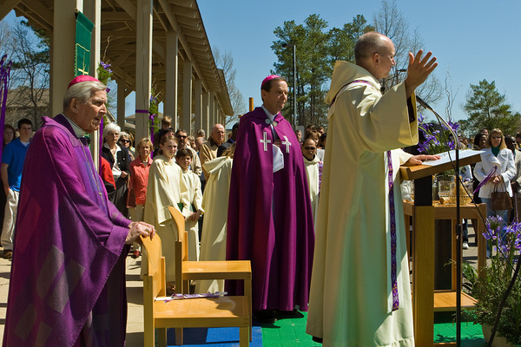
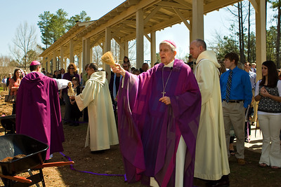
I’m building the Body of Christ
The role of pastor is twofold:
Maintain continuity with the past,
Lead change that produces new growth & development
Notes:
However, the role of pastor is twofold: to maintain continuity with the past, and also to lead change that produces new growth and development.

Slide 6
Cathedral Inscription:
“Lector,
si monumentum requiris, circumspice”
Epitaph:
“not for his own
but for the public good.”

Slide 7
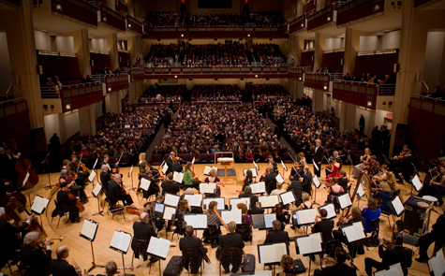
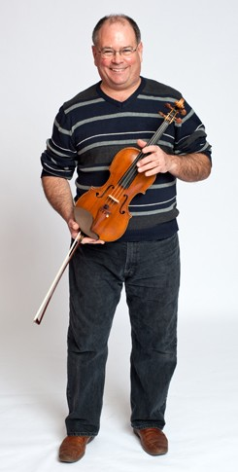
North Carolina Symphony
Raleigh, NC
Brian Reagin, 1st Violinist

Slide 8
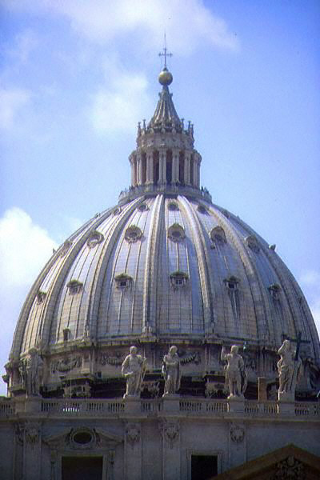
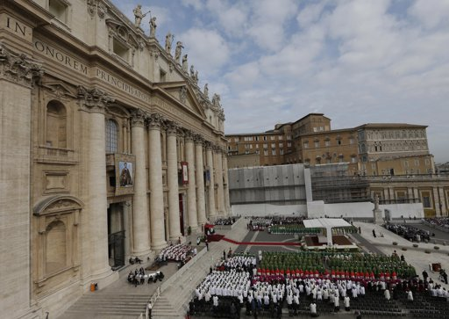
Evangelizing is in fact the grace and vocation
proper to the Church, her deepest identity.
She exists in order to evangelize . . .
EVANGELII NUNTIANDI (Paul VI)
The Church exists
to evangelize
Pope Benedict XVI
Synod on the New Evangelization
7 October 2012

Slide 9
What is Collaboration?
What is your
definition of collaboration?
Notes:
Christine

Slide 10
Collaboration:
The identification, release and union of the gifts of all baptized persons for the sake of the mission.
The essence of collaboration is to develop a church in which people continue to discover new and better ways of working together in ministry toward that common mission.
Collaboration: Uniting Our Gifts in Ministry by Loughlan Sofield ST & Carroll Juliano, SHCJ
Notes:
Vatican II ecclesiology –
150 employees – I’m the last interview – ask questions about mission / collaboration / Franciscan tradition / BST

Slide 11
Spirituality of Collaboration
Moves to compassionate action
Encompasses forgiveness
Is reflective
Is shared
Fits the person
Is affective
Is able to integrate failure
Collaboration: Uniting Our Gifts in Ministry by Loughlan Sofield ST & Carroll Juliano, SHCJ
Notes:
There is not just one systematically formed model of spirituality for ministry.
There are some clearly discernable elements of a spirituality for collaborative ministry, which are reflected on the slide
Spirituality is primarily one’s relationship with God as it affects every aspect of a person’s life (especially in ministry)
Spirituality is relational and affects one’s relationship with others and with the environment
Integrate failure – in fire gold is tested, chosen ministers in the crucible of humiliation

Slide 12
Why Collaboration?
The Church founded by Jesus Christ
is a Church of and on a mission.
It is an apostolic Church; an evangelizing Church.
The greater the collaboration,
the greater the growth of this apostolic Church.
Failure to develop a more collaborative approach
to ministry condemns the Church to mere survival.
A non-collaborative Church is a Church of maintenance rather than a Church of mission.
Collaborative ministry
is messy, sometimes, difficult, and at times, painful.
Collaboration: Uniting Our Gifts in Ministry by Loughlan Sofield ST & Carroll Juliano, SHCJ

Slide 13
Collaboration is messy
and possible only when each collaborator is willing to engage
in the difficult and, at times
painful personal reflection,
assessment, conversion.
Collaboration: Uniting Our Gifts in Ministry by Loughlan Sofield ST & Carroll Juliano, SHCJ
Notes:
But I believe is worthwhile – all for the mission of the Word incarnate Jesus Christ and his mission – the reign of God.

Slide 14
How do we collaborate?
The four stages of collaboration:
Co-existence . . .
. . . Communication . . .
. . . Cooperation . . .
. . . Collaboration . . .
Always for the sake of the Mission
Collaboration: Uniting Our Gifts in Ministry by Loughlan Sofield ST & Carroll Juliano, SHCJ

Slide 15
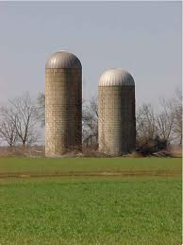
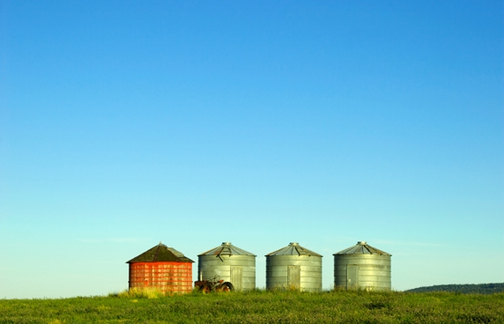
From co-existence . . .
Notes:
Silo’s can be beautiful
Example of co-existence – school vs parish mentality;

Slide 16
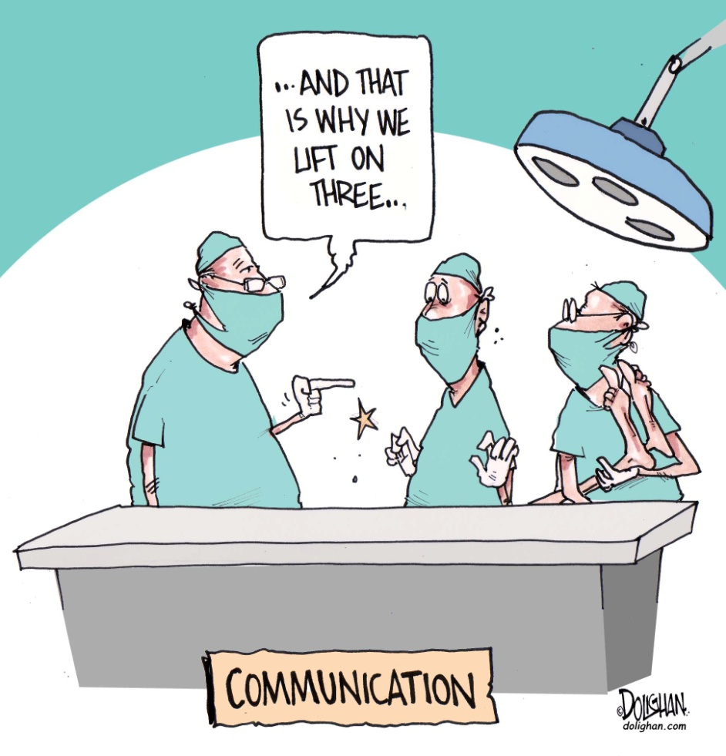
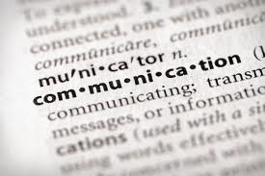
to communication,
Notes:
We’re working together – lifting together, sharing ideas, the left hand knows what the right hand is doing – may not be cooperating with each other, but there’s shared knowledge
communication – making sure all ministries are informed of events;

Slide 17

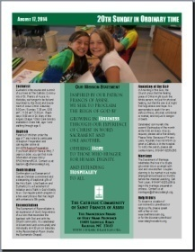
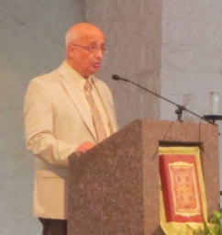


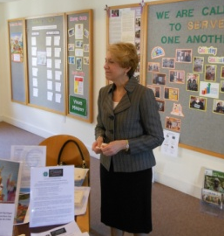
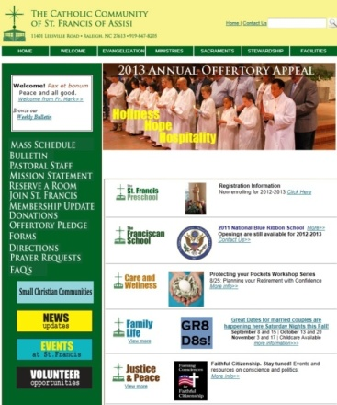




Communications: Social Media
In Church
Pulpit
Stewardship Center
Ministry
Leaders

Slide 18
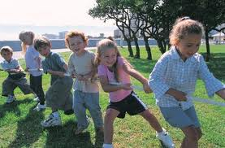
to cooperation
Notes:
Not only pulling together, we’re talking about, strategizing, moving in same direction
Strategic planning – communication – making sure all ministries are informed of events;
cooperation – realizing that working together can be beneficial for all ministries (Operation Rice Bowl);

Slide 19
and collaboration
Notes:
Like the reign of God – glimpses and moments of collaboration – not an end it itself.
collaboration – interweaving events/ministries - always thinking about how can this event/ministry be improved by working collaboratively
All Employee Gatherings – assigned seating;
Formation Day; Advent Afternoon of Reflection; Epiphany Party, Founders Day, Retreat for all full-time 12 month employees, Staff Meetings (Faith Sharing, Formation), Staff Presence at Liturgy, school sees itself as a ministry of the parish – not a separate entity

Slide 20
From co-existence to communication, cooperation and collaboration
Generally,
where would you place
your pastoral staff on the spectrum?
Notes:
Story of Loughlan asking where we were on the contingency of the 4 C’s

Slide 21

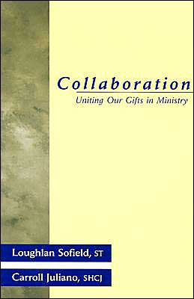
1. Clarification
Notes:
Clarify – working definition – Collaboration: Uniting our gifts in ministry required reading – common language

Slide 22
Clarification
“It is essential for us to understand
that Jesus has a specific task in life
for each and every one of us.
Each one of us is handpicked,
called by name, called by Jesus.
There is no one among us
who does not have a divine vocation.” (John Paul II)
Collaboration is a form of ministry
based completely on the concept of gift.
Notes:
collaboration is a buzz word. It is important to continually come back to the meaningful definition that collaboration is a form of ministry based on gift.
The identification, release, and uniting of gifts for the sake of the mission. it is intentional, strive for it.

Slide 23
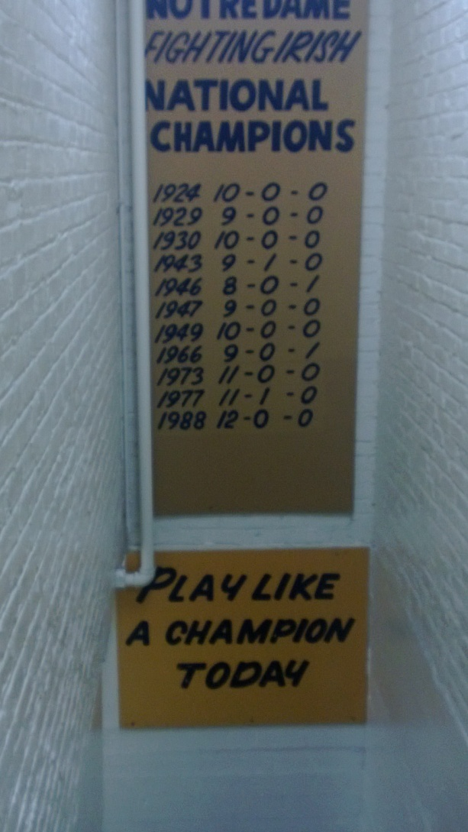
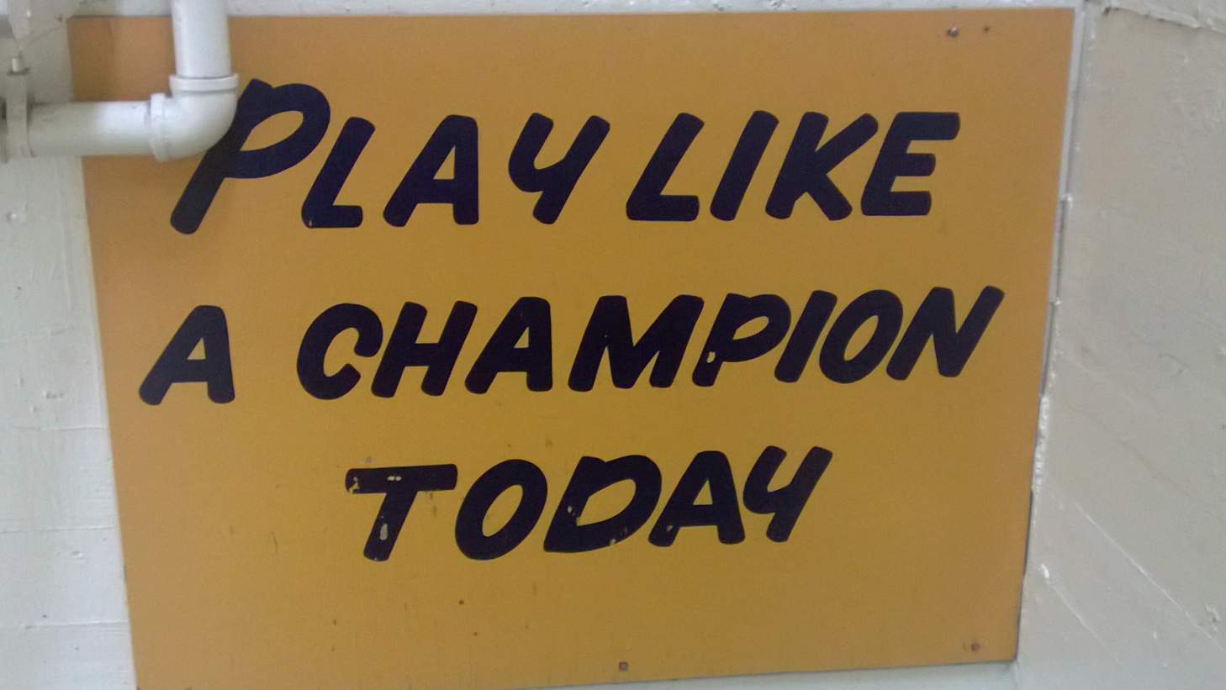
2. Conviction
Notes:
Conviction: Interview process -- orientation – COO teaches
Commitment to the process of collaborative ministry will endure to the degree that those involved have a strong internal conviction of its importance and value.
Without this internal conviction, a group will abandon its collaborative efforts as soon as the messiness begins leaking into daily encounters.
Family Systems, Orientation to parish for new employees (including school employees), saying yes when you can say Yes, and saying no when you can say No; Franciscan Charism; financial commitment – 10% tithe to tuition assistance and 10% to Peace and Justice; shared space – names of buildings language; SI process; Curriculum Development – CST Talk about the value of this – why would this be important – think about your own work in your ministry – how can your vocation be strengthened? how can the church be strengthened by focusing on collaboration?

Slide 24
SFA Goals of pastoral staff’s work together:
Learn how emotional systems work: key concepts of Bowen Theory applied to parish life
Learn how to be a better observer of the dynamics of emotional process within your ministry
Learn how to function as a more effective leader by attending to emotional process
Provide a context that offers mutual support & encouragement to learn about and work on self-differentiation
Notes:
One workshop not enough – ongoing process – average 3X year all hands workshop with these goals
Also small group work by department
As pastor, I have the most / greatest impact upon the system – but I’m not the only one who impacts the system. Each person does – The “higher” up in the system, often the greater the impact.

Slide 25
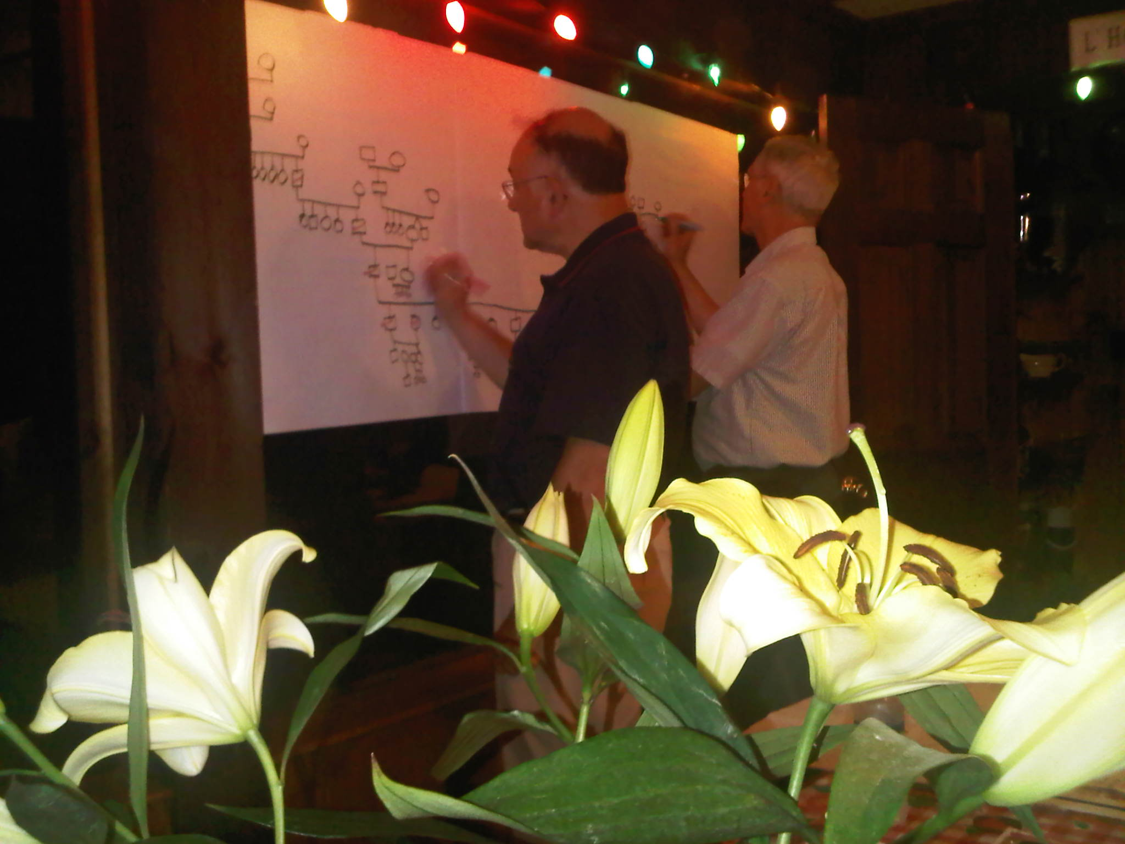
3. Commitment
Notes:
Commitment – Books read & discussed - -it’s not going away
Commitment to collaboration is possible only when one is willing to confront fears and obstacles which are internal and personal.
Many people are more comfortable focusing on the obstacles which are external to them.
It is less personally threatening to blame a lack of commitment to collaboration on the hierarchical church, the sponsoring institutions, or the inadequacies of co-workers. I’m perfect – you are the people with the problems” syndrome.
The problem is with the men running the Catholic Church or those Friars or Jesuits or those crazy church people I work with.

Slide 26
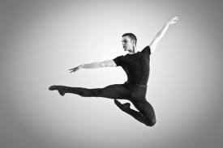
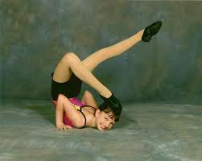
4. Capacity / Capability
Notes:
Capacity / Capability – hope for the best
Skills
Spirituality
Process
MaturityAmong the skills required for collaboration are group leadership, conflict resolution and management, confrontation, and discernment of gifts.
A collaborative spirituality leads a person toward compassionate action and acts of forgiveness that witness to the presence of Jesus Christ.
The process contains a number of elements: a common, gospel-oriented, collaborative vision, a method for identifying gifts, a structure which assures that the gifts are used for ministry, a clarification of roles and authority, and a system for accountability and evaluation.
The most important element is the identification or discernment of gifts.
Are you ready?
“Am I mature enough to collaborate?”
“Do I have the ability to be generative – that is to move beyond self and to extend care and concern for others?”

Slide 27
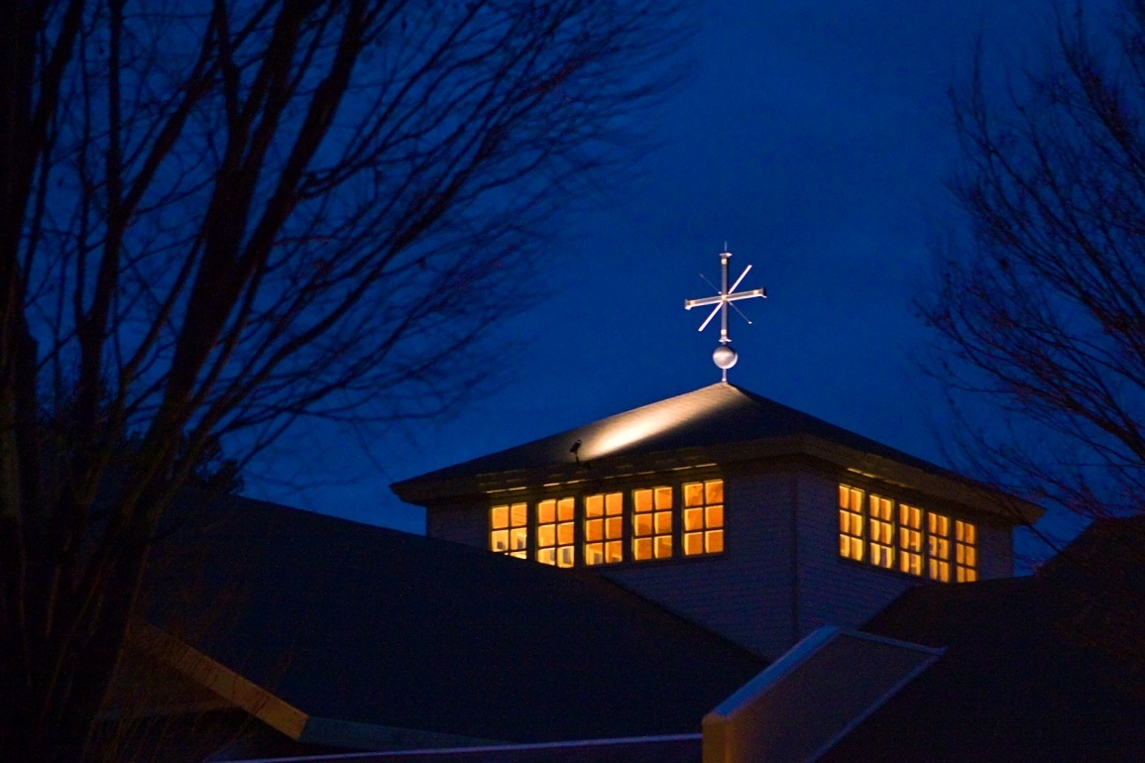
Experiences of Collaboration
All Employee Gatherings | Staff Meetings | Additional Experiences
Formation Day (November) | Opportunity for Faith Sharing and Formation | Collaboration Ministry Award for an employee who exemplifies collaboration
Morning of Reflection (August) | Brings various ministries together. | Summer Staff Retreat
Epiphany Party (January) | Family Systems Theory Resilient Leadership | Collaborative Liturgical Planning
Founders Day (April 25) | Parish Strategic Initiatives | Leadership Summits Volunteer Ministry Leaders (2X year)
Notes:
we are at various stages depending on the ministry; topic; issue.

Slide 28
Why Collaboration?
The Church founded by Jesus Christ
is a Church of and on a mission.
It is an apostolic Church; an evangelizing Church.
The greater the collaboration,
the greater the growth of this apostolic Church.
Failure to develop a more collaborative approach
to ministry condemns the Church to mere survival.
A non-collaborative Church is a Church of maintenance rather than a Church of mission.
Collaborative ministry
is messy, sometimes, difficult, and at times, painful.
Collaboration: Uniting Our Gifts in Ministry by Loughlan Sofield ST & Carroll Juliano, SHCJ

Slide 29
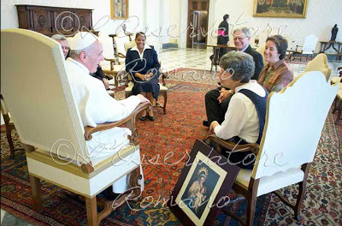
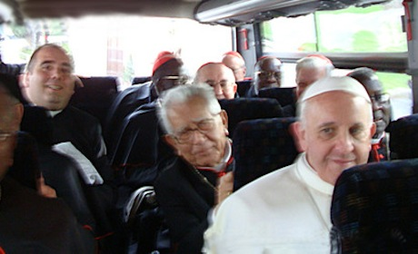
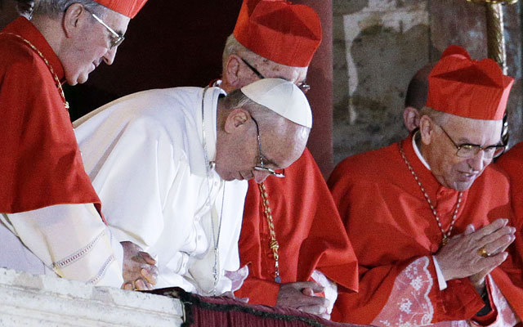
What does a collaborative person
look like?

Slide 30
The identification,
release and union
of the gifts
of all baptized persons
for the sake of the mission.

Slide 31

2008 Study
Paying the Bills
vs.
Living the Vision

Slide 32
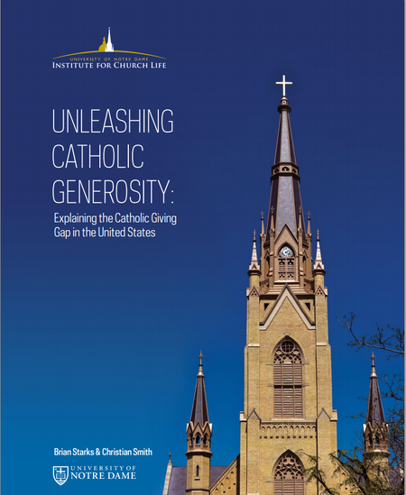
“In short,
parish cultures
that focus on ‘living the vision’
have parishioners
who report
higher levels
of giving.”

Slide 33
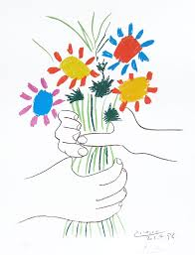
What you have received as a gift, give as a gift
Keep giving
the gift away

Slide 34
9:15 a.m. Keynote, Part 1 (Fr. Mark Reamer) The inspirational talk will reflect Matthew 10:8 and the bishops’ definition of stewardship:
“We receive God's gifts gratefully,
cultivate them responsibly,
share them lovingly in justice with others,
and return them with increase to the Lord.”
Fr. Mark will inspire us to live the vision of stewardship (not just pay the bills!)
while challenging us to bring forth
the gifts of the baptized.

Slide 35

Questions? Comments!
Fr. Mark G. Reamer, O.F.M.
Siena College
Loudonville, New York
518/783-2938
Mreamer@Siena.edu
www.Siena.edu
Sue Mathys
The Catholic Community of St. Francis of Assisi
Raleigh, North Carolina
919-847-8205 x. 222
sue.mathys@stfrancisraleigh.org
www.stfrancisraleigh.org

Slide 36
Purpose for Today
The Stewardship Cycle throughout the liturgical year
Practical (and easy) steps to encourage a year round focus on stewardship. This talk will encourage participants to dream big while taking small steps to form their parish community in the spirituality (and science) of stewardship.

